Slide 1
Iterator presentation
By Arnold Goncharenko

Slide 2
Agenda
Describing the design pattern
UML Diagram of the pattern
Context of usage
Real life example
How it is related to other patterns

Slide 3
Description of an iterator
Named iterator or cursor
Main classification is behavioral pattern
The main intent
Access elements without exposing how it works

Slide 4
UML Description
Used for traversing a list in different ways
The pattern’s idea is to take control
Accessing
Traversal
Used to keep track of current elements

Slide 5
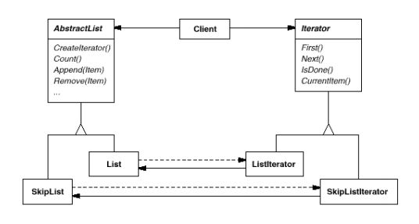
UML Description (Cont.)

Slide 6
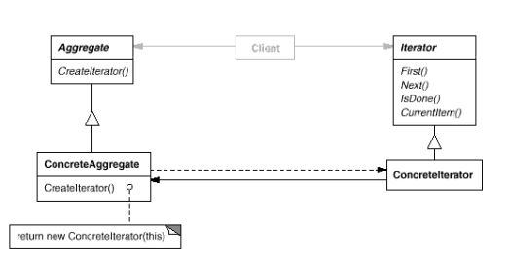
UML Description (Cont.)

Slide 7
Context
Access an objects contents with no exposure
Support multiple traversals of those objects
Uniform interface for going through different structures

Slide 8
Real life example
Part of foundation library, booch components [boo94], and small talk
Will be covering small talk
Standard collection classes define internal iterators
Each element is bound to a local var in a block
Block is then executed
Read stream in small talk is also an iterator
No standard iterators in small talk
At least no for non-sequential collection
Set
Dictionary

Slide 9
Related patterns
Composite
Iterators applied to recursive structures
Factory method
Iterators rely on factory methods to make correct iterators
Memento
Used with iterators
Iterators use memento to capture state
Iterator stores memento

Slide 10
Thanks for listening!

